Slide 1
Introduction of international transport emissions: Ties to the UNFCCC and difficulties of regulation in ICAO/IMO
International Transport and the Paris Agreement
Webinar, 31st October 2017
Beatriz Martinez Romera
Faculty of Law

Slide 2
Outline
Regulation under the climate change regime
Regulation under ICAO and the IMO
Future regulation

Slide 3
Climate Change Regime
1992 - UN Framework Convention on Climate Change (UNFCCC)
“stabilization of greenhouse gas concentrations in the atmosphere at a level that would prevent dangerous anthropogenic interference with the climate system…”
(Art 2 UNFCCC)
Notes:
3

Slide 4
Climate Change Regime
Art. 4.1 (c) UNFCCC
“Promote and cooperate in the development, application and diffusion, including transfer, of technologies, practices and processes that control, reduce or prevent anthropogenic emissions of greenhouse gases not controlled by the Montreal Protocol in all relevant sectors, including the energy, transport, industry, agriculture, forestry and waste management sectors;”

Slide 5
Climate Change Regime
Key issue:
Domestic Emissions – GHG emissions from fuels used in national aviation and maritime transport
Included in national totals
International Emissions – GHG emissions from fuels used in international aviation and maritime transport
Reported separately

Slide 6
Climate Change Regime
1997 - Kyoto Protocol
Excluded international aviation and shipping from its targets.
“The Parties included in Annex I shall pursue limitation or reduction of emissions of greenhouse gases not controlled by the Montreal Protocol from aviation and marine bunker fuels, working through the International Civil Aviation Organization and the International Maritime Organization, respectively.” (Art.2.2 KP)

Slide 7
Climate Change Regime
Subsidiary Body for Scientific and Technological Advice(SBSTA)
cooperation in improving data for inventories
ICAO and IMO reporting progress
Ad Hoc Working Group Long Cooperative Action (AWG-LCA)
within the mitigation chapter: “cooperative sectoral approaches and sector-specific actions to enhance implementation of art. 4.1(c) UNFCCC”
Outcome AWG-LCA “Agrees to continue its consideration of issues related to addressing emissions from international aviation and maritime transport”
Ad Hoc Working Group on the Durban Platform for Enhanced Action (ADP)
to develop ‘a protocol, another legal instrument or an agreed outcome with legal force’ to be concluded in 2015
Notes:
7

Slide 8
Paris Agreement
No mention in the Paris Agreement
Not excluded from the aims of the agreement
However, the main mitigation tool in the agreement (NDCs) is ill-equipped to deal with international aviation and shipping emissions.
Notes:
8

Slide 9
International Civil Aviation Organization (ICAO)
Action: studies, committees, WGs, reporting to SBSTA
ICAO Basket of Measures:
1&2.Technical and operational
Co2 Stardard for new aircraft, alternative fuels
3.MBMs:
38th Assembly – Agreed to adopt a Global MBM by 2016
39th ICAO Assembly – Adopted GMBM
CORSIA

Slide 10
International Maritime Organization
Action: studies, committees, WGs, reporting to SBSTA
3 Pillars:
1&2.Technical and operational
2011 - EEDI , SEEMP, EEOI + Tech Transfer - 2013
3.MBMs:
Discussions suspended in 2013
MEPC 7O – Roadmap – adopt a strategy by 2018
MEPC 71 - Data Collection

Slide 11
Areas of friction:
Disagreement over the competent forum to regulate
Disagreement over the principles applying
(Differential and equal treatment)
3. Disagreement over the emissions reduction target to be achieved
(relates to the objectives of the regimes)
Disagreement over the way to achieve these reductions.
(the use of market-based mechanisms)

Slide 12
Forum Shifting – Consolidation of ICAO and IMO as multilateral fora However, international aviation and shipping are still anchored in the climate regime role for the Facilitative Dialogue Strengthening and increase of unilateral action aiming to prompt action at the multilateral level but also to fulfil countries commitments under the Paris Agreement
Future Regulation

Slide 13
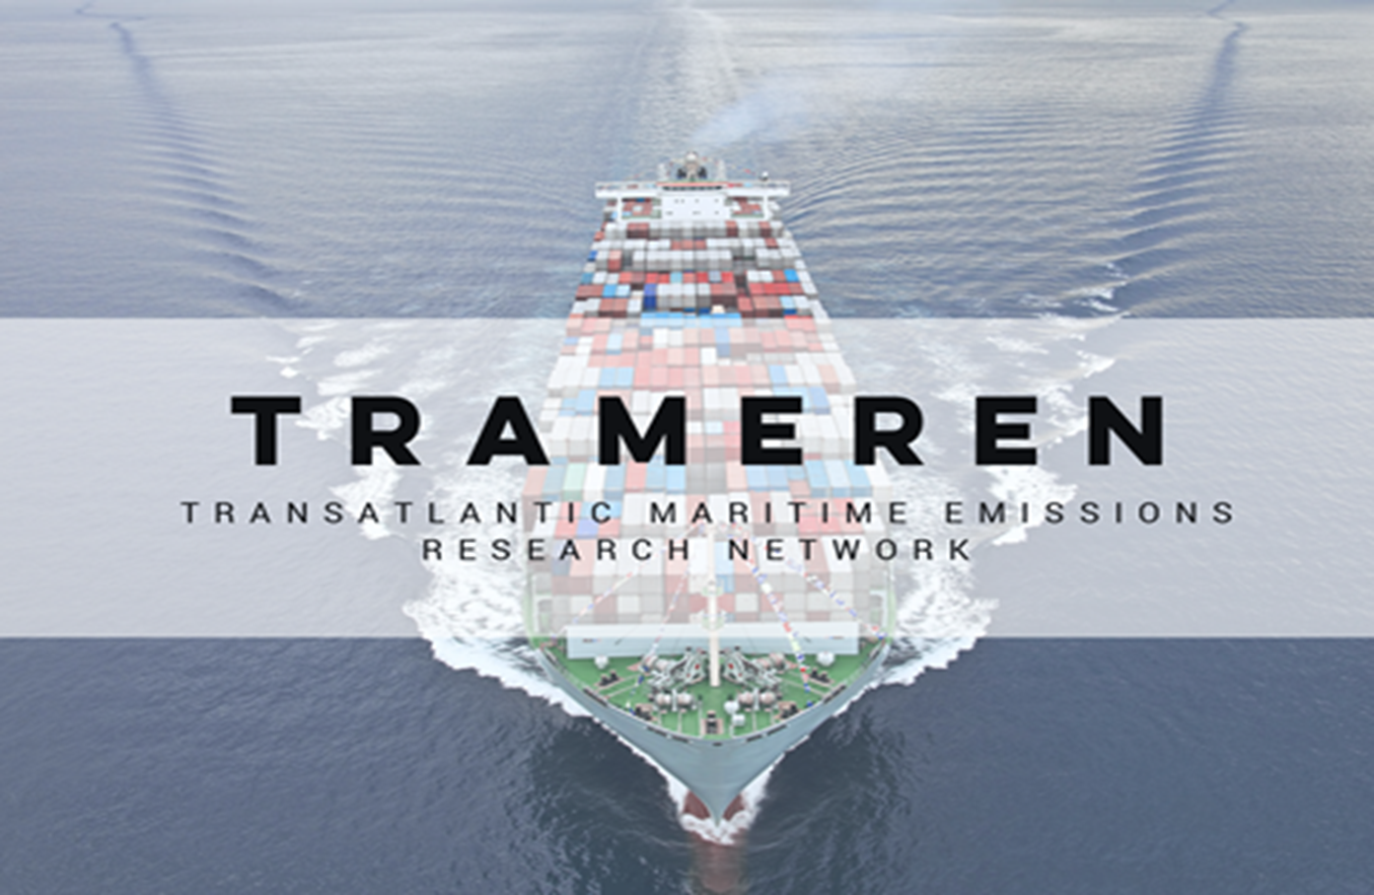
Thank you
www.trameren.dk
Beatriz.Martinez.Romera@jur.ku.dk

