Slide 1
N-Fix Technology – New delivery system for Nitrogen
Peter Blezard - CEO

Slide 2
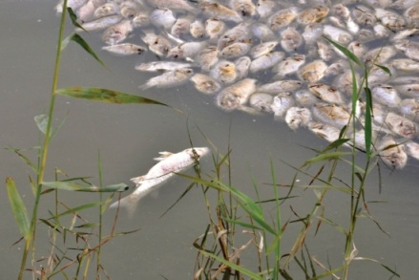
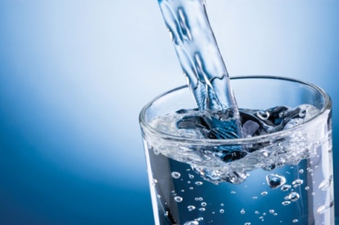
Issues With Nitrogen-Based Fertilisers
Overuse of Nitrogen Fertilisers on crops causes Nitrate pollution which can lead to:
Dead zones
Water contamination
Greenhouse gases
Negative impact on animal and human health

Slide 3
N-Fix Technology
Is the only proven technology that enables
all crop species to fix nitrogen directly from air
The technology Gluconacetobacter diazotrophicus (Gd) was originally developed by Professor Ted Cocking FRS
Patented disruptive technology which will have a huge impact on agriculture
Contains no toxins and is neither genetic modification (GM) nor bioengineering
Enables naturally sustainable farming without nitrogen pollution
Increased profit for farmers through reduced fertiliser usage and increased yields

Slide 4
N-Fix
All plants require nitrogen however as they are unable to use atmospheric nitrogen, they rely on sourcing active nitrogen from the soil.
Our N-fix technology provides every cell in the plant with the ability to fix its own nitrogen from the air.
N-Fix
(Nitrogen Fixing Bacteria)
Coated Seed
Notes:
Modern farming relies on costly and environmentally damaging synthetic nitrogen fertiliser to augment the naturally occurring nitrates to meet the ever increasing demand for higher yield.

Slide 5
Field Trial Results
Into 6th season of field trials
2015 is the 1st year Azotic is delivering 3rd party independent field trial results
2015 – 37 field trials in 8 countries on 7 different crops
2016 - 73 field trials with CROs in 9 countries covering 6 crops
UK
France
Belgium
Germany
Italy
Spain
Hungary
Bulgaria
South Africa
USA
Canada

Slide 6
Field Trial Results
Proof of colonisation
Increase in yield 7% in Belgium and 21% in Germany
Saving on average of 50% of N fertiliser
Belgian and German results indicate an overall potential reduction in nitrogen fertiliser of 40% and 95% respectively without suffering any yield penalty
Proof of colonisation
Saving on average of 50% of N fertiliser
15% yield increase
Substitution of 50% of recommended rate of nitrogen fertiliser (N) achieved greater yield than full recommended rate of N

Slide 7
The Way Forward
Agriculture must change
Biologicals will contribute to sustainable agriculture
Increase food production through new science not more planet
Regulatory action to reduce nitrogen pollution from agriculture e.g. NVZs
We need to work together on regulatory action to reduce nitrogen pollution from agriculture

Slide 8
Our Vision
Our Vision
The
nitrogen industry
is worth approx.
$110bn annually.
We're going to revolutionise this industry.
We're going to
change the way that people grow food.
What we have created will
affect every single person on the planet
now AND our future generations.
We have created the
single most important breakthrough in agriculture
in the
last 100 years.
Notes:
Azotic’s proprietary and patent protected technology products will initially deliver a 50% nitrogen fertiliser reduction in addition to a 10% yield gain – a game changer in the $110bn nitrogen fertiliser market.
Azotic’s technology is the most significant step towards high yield sustainable agriculture since the introduction, in 1730, of the four-course system of crop rotation.

Slide 9
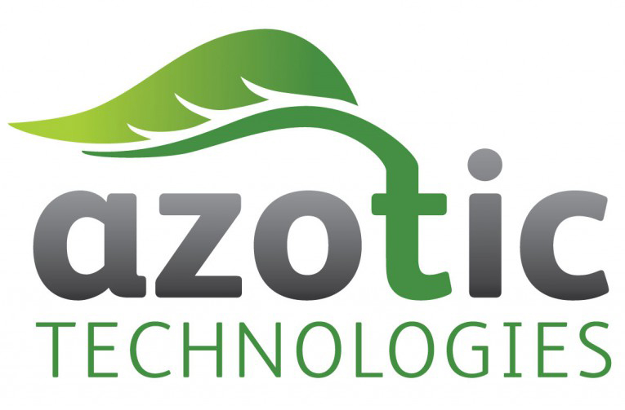
Thank You
The future in sustainable nitrogen

