Slide 1
Industry’s low-carbon transition and the role of the EU ETS
Brussels, 25 May 2016
Femke de Jong
EU policy director, Carbon Market Watch

Slide 2
Industry’s emissions have declined significantly since 1990
Emissions from the chemical sector have decreased by almost 60%
From over 300 Mt CO₂-eq in 1990 to less than 150 Mt in 2013
Most of this mitigation due to reductions in process emissions
Emissions from the steel sector have decreased by almost 40%
In 2013, total EU emissions from steelmaking were 166 Mt CO₂-eq
Recent decarbonisation efforts contributed to the mitigation, but the recession and closure of steel plants also played a role
Emissions from the cement sector have decreased by almost 40%
From over 160 Mt CO2-eq in 1990 to over 100 Mt in 2013
Reductions occurred mainly due to lower production levels

Slide 3
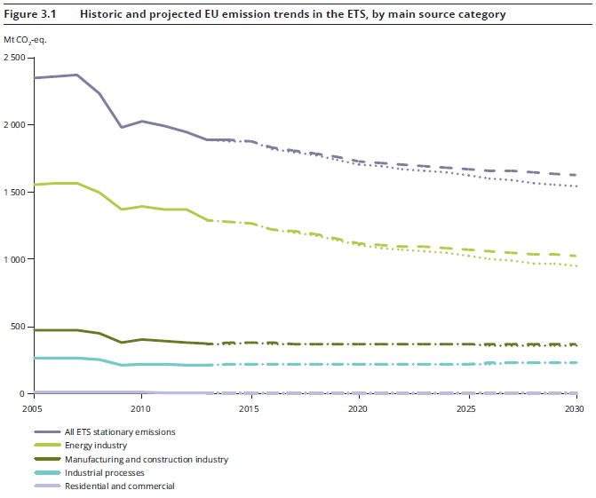
Industry’s emissions are not projected to decline in the coming 15 years
Without a change of the rules, the European Environment Agency (EEA, 2015) projects that industry’s emission reductions will stall over the next 15 years

Slide 4
Decarbonising the EU’s economy still requires significant emission cuts in industry
The EC’s 2050 low-carbon roadmap: 83-87% emission reductions in industry (compared to 1990) needed to reach domestic economy-wide reductions of 80% by 2050

Slide 5
Emission reductions of over 80% by 2050 are possible in the EU’s manufacturing sectors
Not easy, as most of the low-hanging fruit has been picked already
Industry faces other major challenges (capacity surpluses, competition with regions that have better access to raw materials & larger domestic markets)
Also an opportunity: focus on climate-friendly solutions with co-benefits that increase the economic performance of industries and reduce the reliance on imports
New process technologies need to be market ready by 2030 for deployment across the EU before 2050
Also think outside the box beyond process innovations
Key issues: circular economy (use more recycled scrap steel, increased recycling of plastics), bio-based economy (bio-based chemicals, fertilisers from bio-waste), transition to high-value-low-volume

Slide 6
How to reap these opportunities of the industry’s low-carbon transition?
Smart public policies are crucial:
Public procurement
Targets (recycling, use of bio-waste in chemical sector, CO₂ standards, limits on the use of fertilisers)
Product standards (eco-design)
Innovation support
Carbon price signal
Avoid regulatory misalignment, such as:
RES target for transport (biomass used for transport rather than for higher—added-value use in chemicals)
Higher regulatory costs for making steel from recycled scrap than from imported iron ore (over-compensation of direct carbon costs)
Perverse free allocation rules under the EU ETS that have caused an increase in cement emissions by over 15 Mt CO₂-eq (see Sandbag report)
Role EU ETS

Slide 7
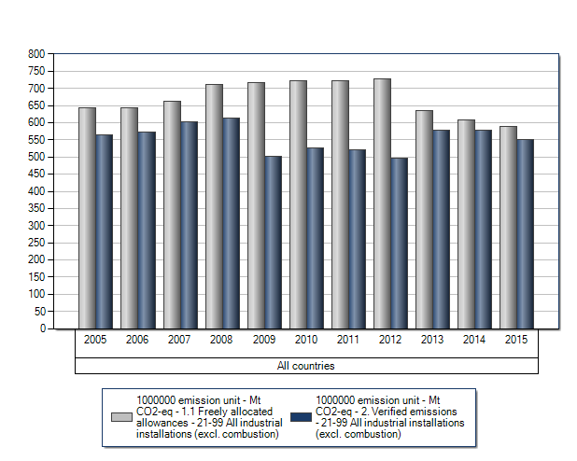
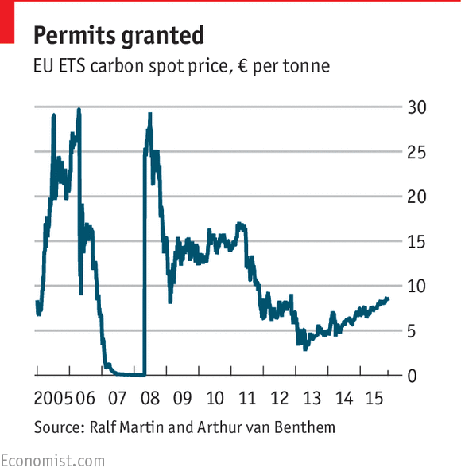
The EU ETS does not provide a carbon price signal to industry at the moment
Problems:
Over-allocation of free emission allowances
Low carbon price
The EU ETS currently does not send the right signals for the climate friendly transition, nor does it reward the frontrunners that have invested in low-carbon technologies

Slide 8
Proposed EU ETS reform does not sufficiently reward low-carbon industry solutions
Pay-outs to industry in form of free carbon permits are over 15 time the amount the EU plans to spend on innovation after 2020
Supporting industry innovation:
400 million allowances,
± €10 billion
Subsidising industry pollution:
6.3 billion allowances,
± €160 billion

Slide 9
EU ETS reform: getting it right
Set a stronger carbon price signal by cancelling surplus emission allowances, introducing a steeper decarbonisation pathway (LRF>2.8%) and starting in 2021 at actual emission levels.
Invest more revenues in climate friendly innovation and support the frontrunners that want to invest in breakthrough technologies.
Phase out the free allocation of emission allowances by gradually increasing the share of allowances to be auctioned from the current 57% to 100% in the future.
Do not give free emission allowances to industries that do not have significant carbon leakage risks by introducing a focused tiered approach to leakage based upon the ability to pass-through costs.
Introduce an incentive to innovate by annually reducing the amount of free allowances that an installation receives (the benchmark) in line with the overall decarbonisation pathway of the EU ETS

Slide 10
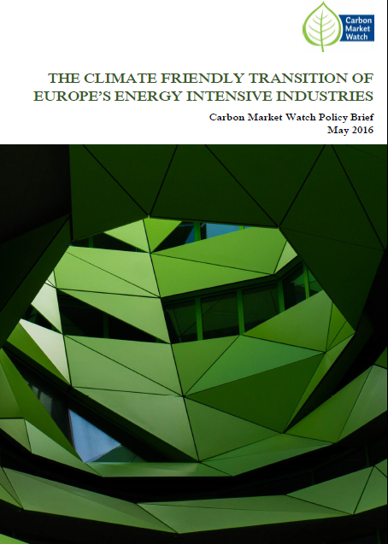
Thank you!
Femke de Jong
Femke.deJong@carbonmarketwatch.org
Read summary briefing here

