Slide 1
Adding more value to less material
Dr. André Cabrera Serrenho, Research Associate
Prof. Julian Allwood, Professor of Engineering and the Environment
European Parliament, Brussels
25th May 2016

Slide 2
Global CO₂ emissions, 2005
(Allwood, J. et al., Sustainable Materials with Both Eyes Open, 2012)
Notes:
Iron and steel industry is the world’s largest industrial source of carbon dioxide emissions.

Slide 3
Energy intensity of crude steel production
The steel industry is the world’s largest industrial source of GHG emissions;
There is no material substitute for steel;
Global crude steel production has grown ~60% over the last decade;
Steel making is already a very efficient process.
(Allwood, J. et al., Sustainable Materials with Both Eyes Open, 2012)

Slide 4
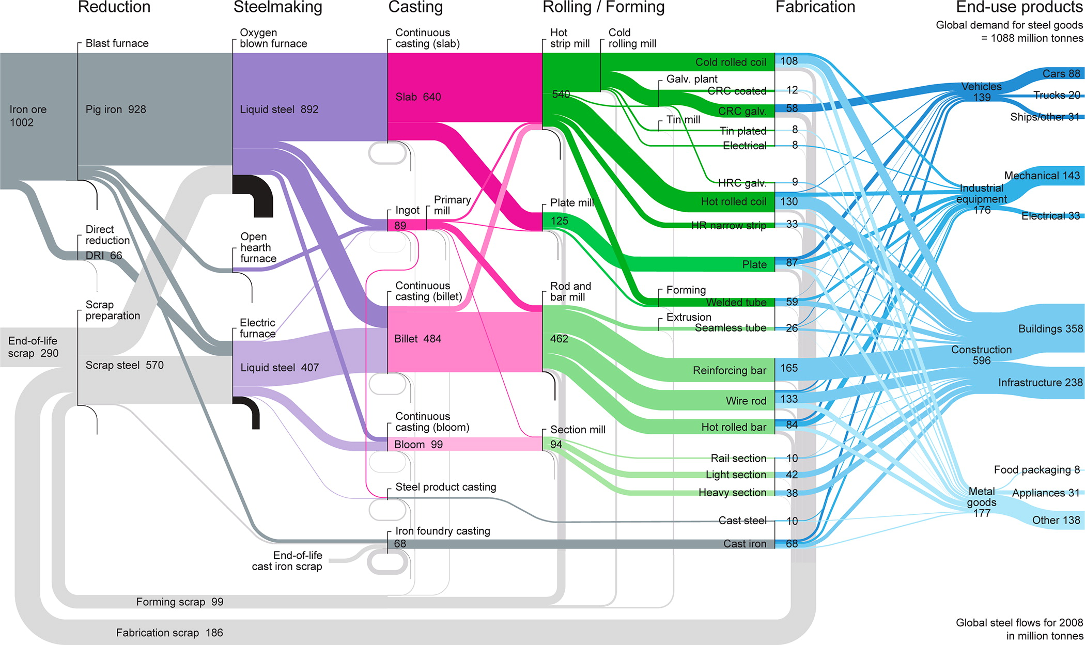
Global steel flows, 2008
Make it lighter
Keep it longer
Use it more
Re-use material
Divert Scrap
Avoid scrap
(Cullen, J. et al., Mapping the global flow of steel: from steelmaking to end-use goods, 2012)

Slide 5
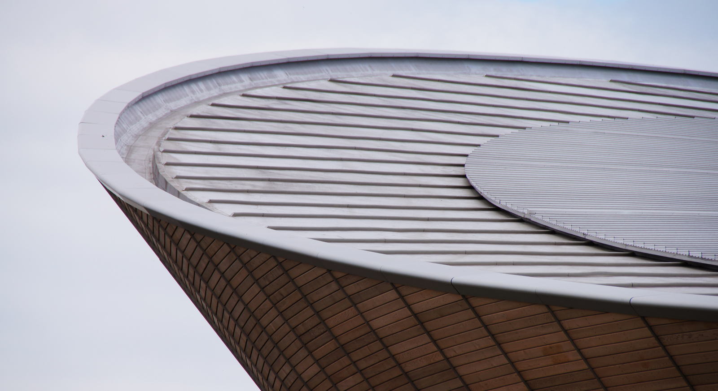
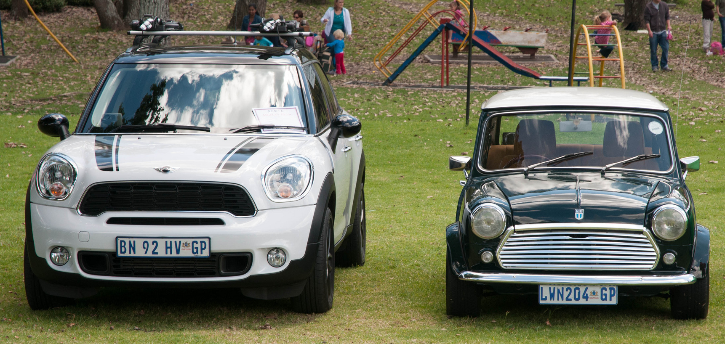
Material demand reduction
Make it lighter
Keep it longer
Use it more
(Cullen, J. et al., Mapping the global flow of steel: from steelmaking to end-use goods, 2012)

Slide 6
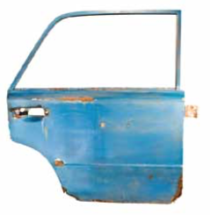
Material demand reduction
(Pippa Horton)
Re-use material
Divert Scrap
Avoid scrap
(Cullen, J. et al., Mapping the global flow of steel: from steelmaking to end-use goods, 2012)

Slide 7
Global production of steel
Scrap availability will treble by 2050;
We will never need to build new blast furnaces.

Slide 8
Global secondary steel-making

Slide 9
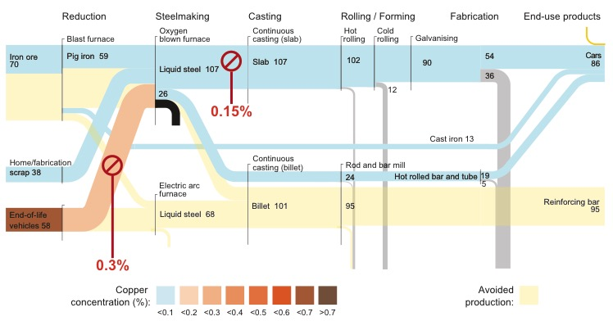
Global secondary steel-making: the opportunity

Slide 10
Global secondary steel-making: emissions savings
2.1

Slide 11
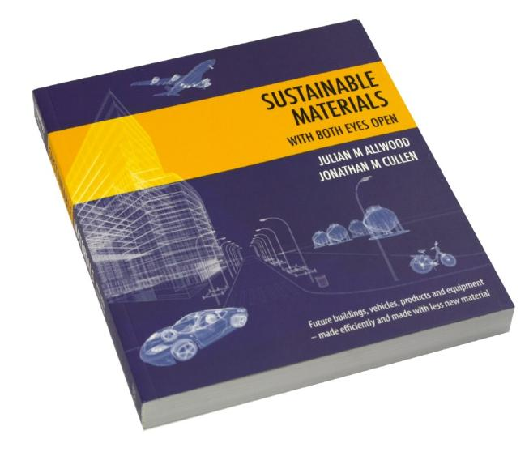
Conclusions
www.withbotheyesopen.com
  Technological transformation is difficult and depends mainly on electricity generation;
  Innovation should focus downstream, where most added value and jobs can be created;
  Innovation support is required to reduce contaminants in end-of-life scrap.

Slide 12
Adding more value to less material
Dr. André Cabrera Serrenho, Research Associate
Prof. Julian Allwood, Professor of Engineering and the Environment
European Parliament, Brussels
25th May 2016

