Slide 1
Mitigating emissions from International Aviation the ongoing story…
Bill Hemmings
March 2013

Slide 2
Transport & Environment
Transport & Environment
Brussels based European Federation
Founding member of International Coalition for Sustainable Aviation – ICSA – the NGO Observers at ICAO since 1999
participants in ICAO CO2 WG developing ICAO CO2 standard for new aircraft
ICSA participant in 2012 ICAO WG on MBMs
we also do cars, vans, trucks, traffic noise, biofuels, air quality, shipping.

Slide 3
ICAO work on technical and political issues
1998-2010 – ICAO CAEP work into open and closed trading systems; taxes, charges; offsets, voluntary initiatives
2004 Assembly agrees no global scheme but recommends national/regional emissions trading
2007 mutual agreement reaction to EU ETS
2008 guidance on implementing emissions trading
2008-2009 – GIACC failed to agree on a plan of action
2009 High Level Meeting on Climate Change;
Declaration on design of MBMs; “Basket of Measures”
2010 Agreed to pursue CO2 standard for new aircraft and
new noise standard – Chapter 14 in 2017

Slide 4
ICAO 37th Assembly Resolution 2010
Discussion on climate change – no consensus on action
2% global annual fuel efficiency improvement goal until 2020 - and an aspirational goal of 2% p.a. 2021 to 2050
set medium-term aspirational goal; keep the global net carbon emissions from int. aviation from 2020 at the same level;
- ie 2020 CNG
Develop State Action Plans
Adopted principles for MBMs
Set de minimis threshold of 1% RTK international activity
operators MBM exempt and States from Action Plans

Slide 5
Current ICAO work
The 37th Assembly Resolution requested the Council to:
review the 1% global RTK de minimis threshold;
develop Framework for market-based measures (MBMs)
explore feasibility of a global MBM scheme, study technical aspects, environmental benefits, economic impacts,
late 2011 Sec Gen call to agree global MBM by end 2012
Group of Experts established January 2012
Three options for MBMs - full access to carbon markets.
- offsetting
- offsetting plus a revenue generation mechanism
- cap and trade emissions trading system
Nov 2012 Council from High Level Group HGCC

Slide 6
EU Stopped Clock for ICAO agreement
Enforcement of extra EU flights suspended until Jan 2014
EU ETS returns Jan 2014 unless changed beforehand
EU will modify if ICAO reaches Assembly global agreement
MEPs say will only amend ETS if ICAO makes real progress
Options for yearend;
Full reinstatement
Outbound flights only; or 50/50
Airspace or FIR
Extend stop the clock – hard sell in EU Parliament
Full suspension - hard sell in EU Parliament

Slide 7
The ICAO battleground
Equal
treatment
(ICAO)
Departing
Flights
Assumed
Consent
Emissions
Trading
Targets
Common But Differentiated
Responsibilities
(UNFCCC)
Airspace
Mutual Agreement
Offsetting
Aspirational
goals
versus
Notes:
“Continued work on a global MBM reinforces the need for a MBM framework to be agreed at 38th Assembly to support interim actions. This was requested by the 37th Assembly and must be delivered.
• The alternative scenario, namely no action at a State level in the absence of a global MBM taking effect, cannot be supported;
• ICAO must act now to create a Framework that provides legal and political certainty to act;
• A Framework must be capable of scaling up to 100% global emissions coverage without duplication. Of the approaches identified to date, only the “all departing flights”, “nationality of carrier” and “FIR airspace” approaches are capable of achieving this objective.”

Slide 8
High Level Group Aviation Climate Change HGCC
Advise on developing a global MBM
Advise on developing the MBM Framework
Discuss basket of measures – US insisted
3 meetings – thats been enough
dissension on global – India, China no responsibility to act
- MBMs voluntary
EU; realistic date for finalising a global MBM could be 2015
others incl US not specific – delay
Very little support for revenue generating option
No discussion on targets, options, allocation
worryingly little progress

Slide 9
Framework for MBM
US declared support for airspace based
already provided for in Chicago
most other countries agreed
except Australia, Canada,{Gulf States}
US; no need mutual agreement if Framework
but airspace no safe haven
India et al; all MBMs voluntary; mutual agreement
might accept airspace over arriving country only
airspace reduces EU ETS by 84%

Slide 10
ICAO; what next?
HGCC Report sidelined as info paper
Secretariat/Council will draft Assembly resolutions
ATC and Council now; Consultations over the summer
Special (Council?) meeting early September
IATA AGM calls for agreement on MBMs at this Assembly
China et al dismiss this at ATC
Key issues;
Agree on global MBM in 2013 to implement in 2016
CBDR – Council has dismissed de minimis proposal
how to treat fast growth carriers fairly.
how can a program based on offsets be environmentally sound?
How to implement globally without new Treaty?

Slide 11
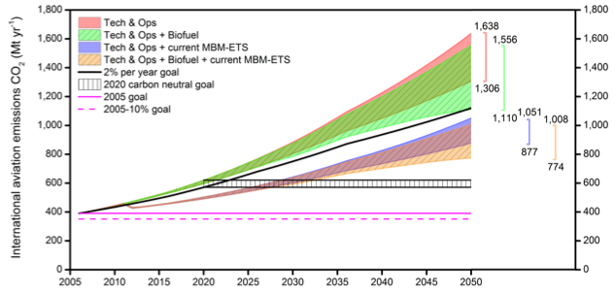
Problem at ICAO; there is an “emissions gap”
PROBLEM: ”None of the [emissions reduction] measures, or their combinations, for any growth scenario managed to meet ICAO’s aspirational 2020 carbon-neutral goal by 2050, the 2005 stabilization of emissions goal, or the 2005-10% stabilization of emissions goal. The 2% goal would only just be met by 2050, through assuming maximum reductions from technology, operations, and “speculative” availability of biofuels.”
Source: Lee. et al. 2013 “Bridging the aviation CO₂ emissions gap: why emissions trading is needed”
Notes:
“In terms of the 2% yr-1 fuel efficiency goal, central growth scenario, none of the S2 to S5 technology and operational improvements alone can meet this goal, S5 falling short of it in 2050 by 185 Mtonnes CO2. If the biofuels are added to the S2 to S5 technology and operational improvement scenarios, the S5-bio just manages to comply by a small amount by 2050 (-10 Mtonnes CO2). Adding the extension of the existing regional MBMs, even to the S2 BAU scenario alone exceeds the 2% yr-1 goal by -69 Mtonnes CO2 in 2050. The addition of “likely” amounts of biofuel to S2/MBM improves this compliance to -112 Mtonnes CO2 in 2050. The maximum compliance is -346 from the full set of measures at MFR, whereas BAU S2, S2bio falling short of the target by a ‘gap’ of 517, 436 Mtonnes CO2 in 2050.
None of the ranges of measures can meet the 2020 carbon-neutral goal in 2050 for the central growth scenario (or the low/high growth scenarios, see Figure 10): the emissions gap for the central growth scenario ranges between 1,107 Mtonnes CO2 (S2) and 153 Mtonnes CO2 (S5bio, MBM) in 2050.
Similarly, none of the ranges of measures can meet either the 2005 stabilization of emissions goal, or the 2005-10% stabilization of emissions goal. The emission gaps are 1,247 to 384 Mtonnes CO2, 1,286 to 423 Mtonnes CO2 at 2005, respectively (central growth scenario).

Slide 12
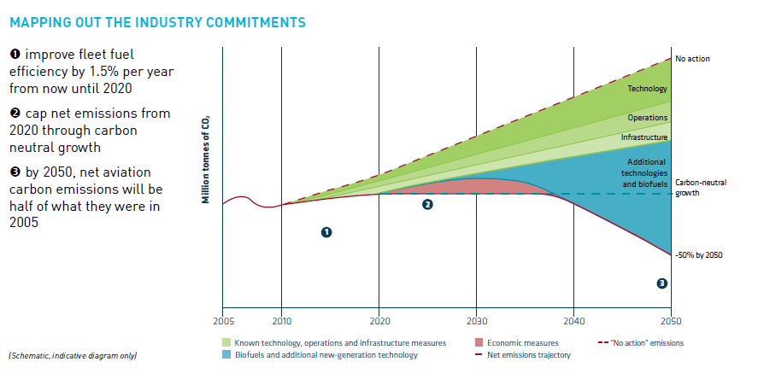
IATA’s Credibility Gap

Slide 13
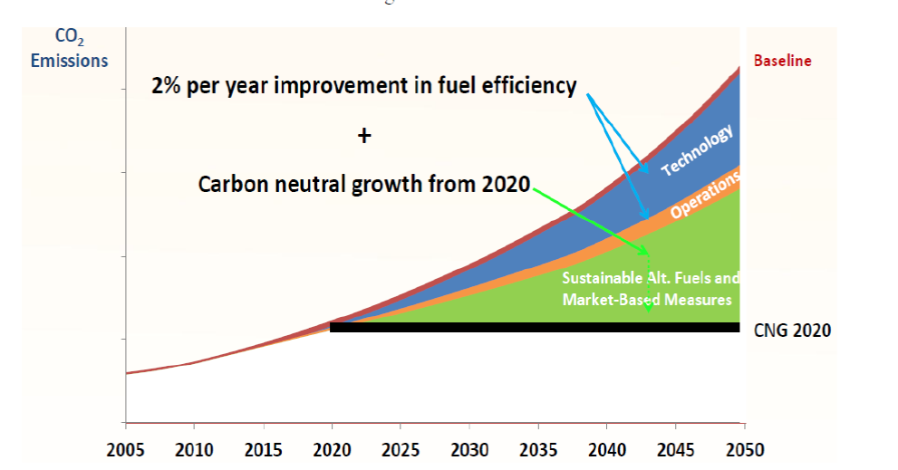
ICAO to UNFCCC Bonn

Slide 14
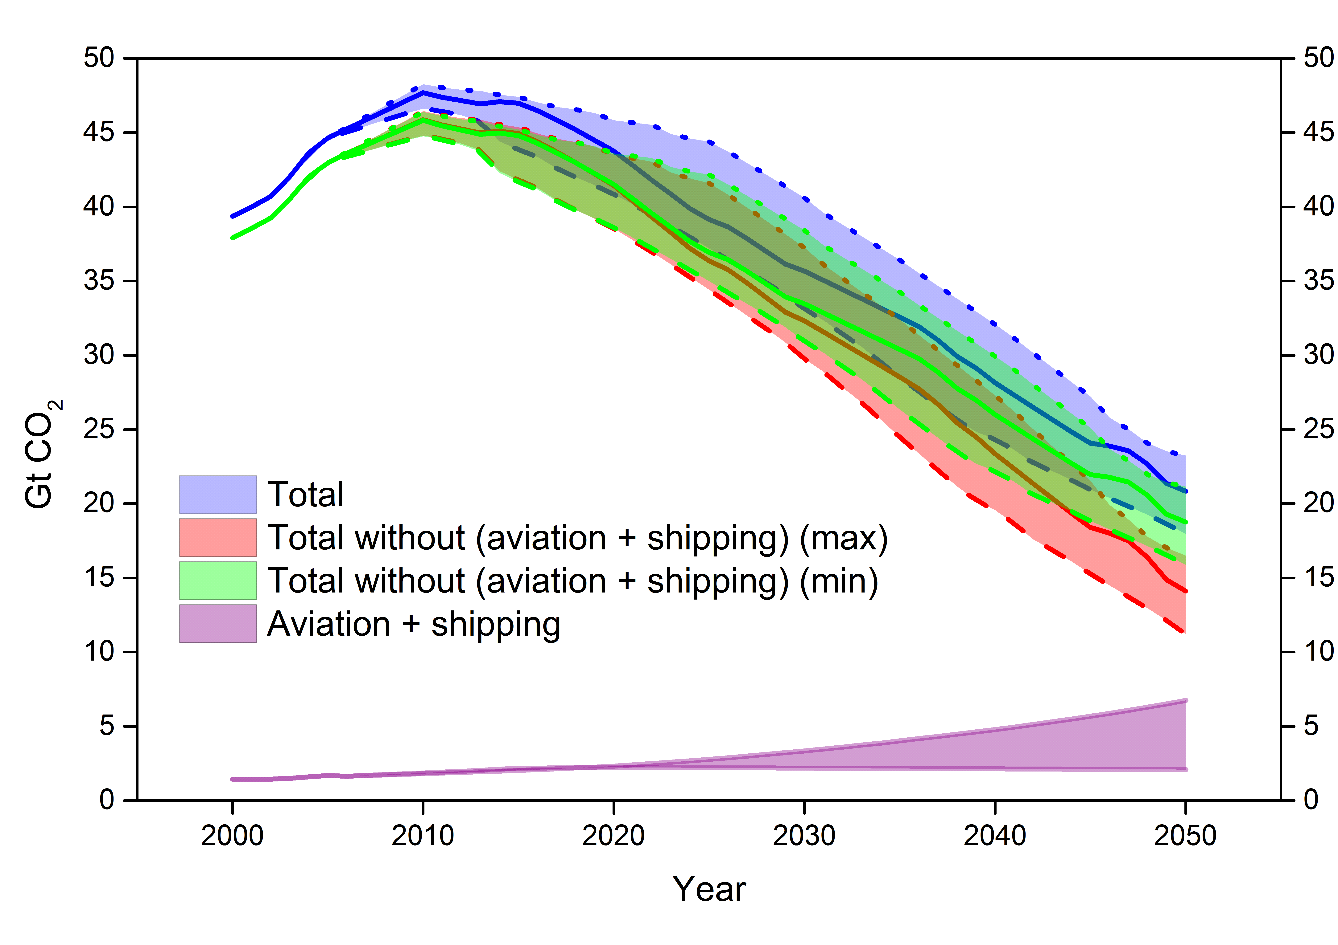
Aviation and shipping in a 2ºC context
Source: Shipping and aviation emissions in the context of a 2°C emission pathway, David S. Lee et al (MMU), March 2013

Slide 15
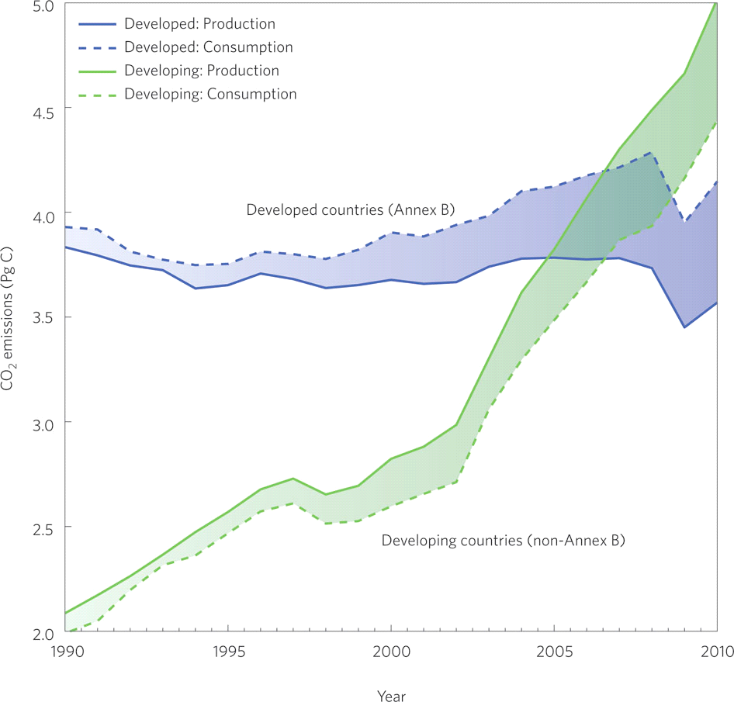
CO2 emissions from
developed and developing States
Source: Peters et al. 2012, Nature

Slide 16
Historical responsibility in aviation
China IACO State Action Plan
Aviation wasn’t around in 1850
“International air transport in developed states enjoys a longer history, a larger market-share worldwide and stable growth. Due to the historical contribution of their international aviation to global climate change, developed countries must shoulder their responsibility for their accumulative historical emissions and the current high level of per capita emissions”
Top historical emitters from 1850 include China, India, Brazil, South Africa
Top 20 historical aviation emitters; China, Singapore, R Korea, UAE, Thailand, Malaysia, Brazil
first flight 1903. first airline KLM 1919
First large jet Boeing 707 1960
first intercon Jet Boeing 747 1970
mass airtravel only took off in 1970
no country emissions data before 1990
ICAO 2010 RTK by country 1974-2009

Slide 17
 | Cum Int RTK 1974-2009 |  |  |  |  | % Total
1 |  | USA |  |  | 17.04%
2 |  | UK |  |  | 8.29%
3 |  | Germany |  |  | 6.72%
4 |  | Japan |  |  | 5.67%
5 |  | France |  |  | 5.04%
6 |  | China |  |  | 4.40%
7 |  | Singapore |  |  | 4.23%
8 |  | Netherlands |  |  | 4.07%
9 |  | R of Korea |  |  | 4.05%
10 |  | Australia |  |  | 2.55%
11 |  | Canada |  |  | 2.24%
12 |  | United Arab Emirates |  |  | 1.92%
13 |  | Thailand |  |  | 1.85%
14 |  | Italy |  |  | 1.81%
15 |  | Switzerland |  |  | 1.64%
16 |  | Spain |  |  | 1.61%
17 |  | Malaysia |  |  | 1.45%
18 |  | Russian Fed |  |  | 1.23%
19 |  | Brazil |  |  | 1.19%
20 |  | Scandinavia |  |  | 1.09%

Slide 18
Cumulative International Aviation Traffic (1974 to 2009 RTK)

Slide 19
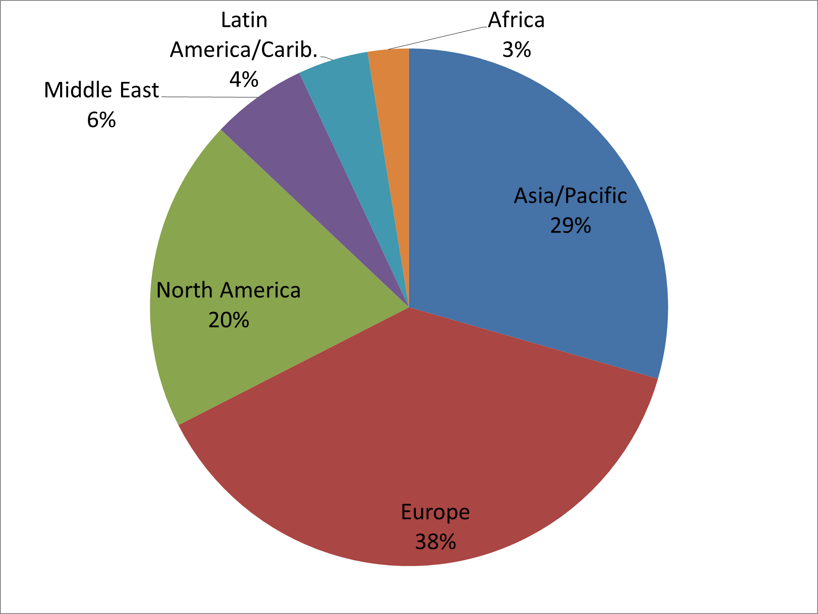
Cumulative International Aviation Traffic (1974 to 2009 RTK) by region

Slide 20
Int Domestic and International Fuel Burn 2010

Slide 21
Global Aviation Emissions 2010 by region

Slide 22
Fuel Burn by Region; 2010

Slide 23
Cumulative fuel burn by region 2020 to 2050

